Slide 1
Understanding the Problem (Need Finding)
Lecture 6

Slide 2
References
Coursera, University of San Diego (Scott Klemmer)
About Face chapter 2

Slide 3
Need Finding (User Research)
Why do we need it?
To build solutions based on evidence
Reduce probability of building the wrong thing.
Ensure solution is relevant and usable.

Slide 4
Design is a systematic and Data Driven Process

Slide 5
Qualitative vs Quantitative Research
Produces quantitative data, such as statistical information
Talks about numbers--- how many? How much?
In most scientific domains quantitative research is done for example in domains of physics, biology etc.
But in understanding users quantitative research can miss many details.
We will use both qualitative and quantitative research but mostly qualitative

Slide 6
Qualitative vs Quantitative Research
Qualitative research helps us understand a product’s domain, context, and constraints in different, more useful ways than quantitative research does.
Behaviors, attitudes, and aptitudes of potential and existing product users
Technical, business, and environmental contexts—the domain—of the product to be designed
Vocabulary and other social aspects of the domain in question
How existing products are used

Slide 7
Qualitative Research
How does the product fit into the broader context of people’s lives?
What goals motivate people to use the product, and what basic tasks help people accomplish these goals?
What experiences do people find compelling? How do these relate to the product being
designed?
What problems do people encounter with their current ways of doing things?

Slide 8
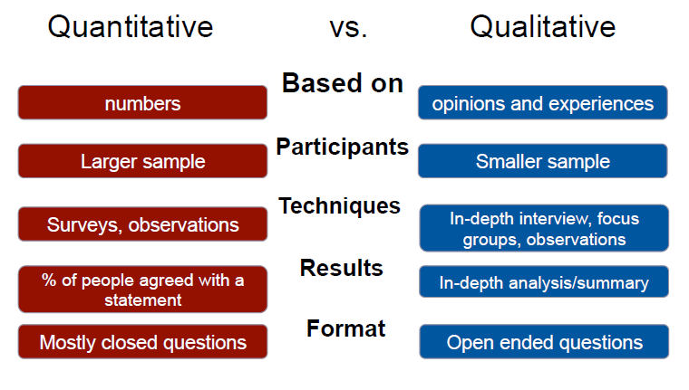

Slide 9
Why are we conducting this particular user research?
Need to figure this part before we go onto actual survey or interview design
What are we trying to uncover

Slide 10

Quantitative Techniques: Surveys
Surveys -> most common
Collection of data about participants (e.g., experiences, opinions)
Selecting a representative sample
Through the use of questionnaires

Slide 11
How to construct questions?

Slide 12
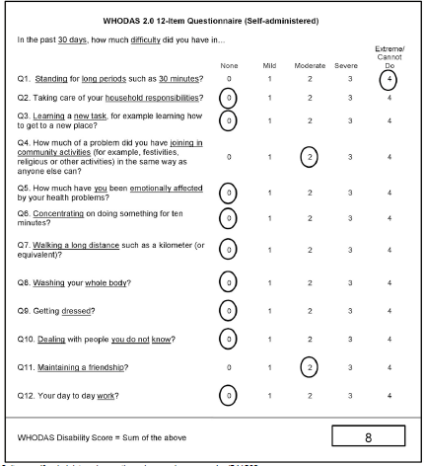

Slide 13
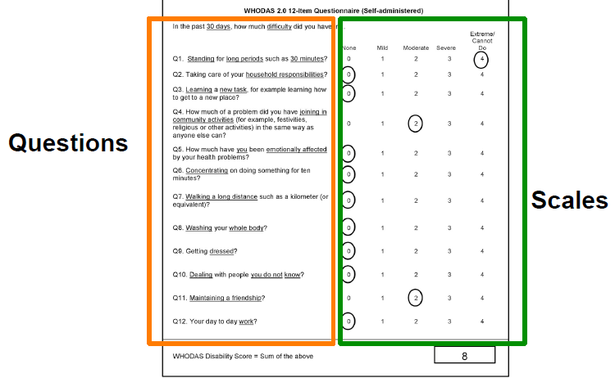

Slide 14
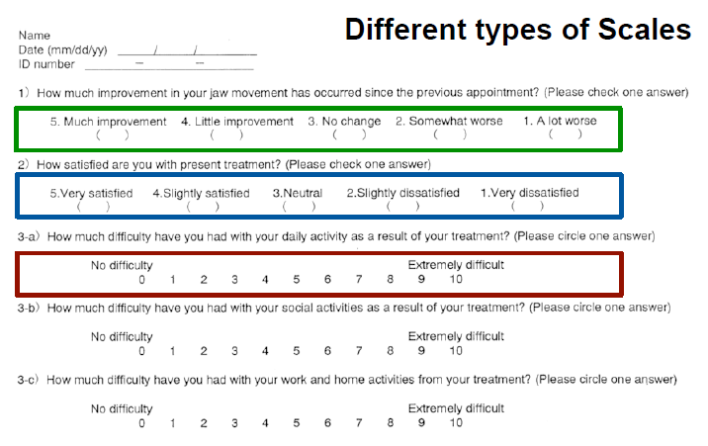

Slide 15
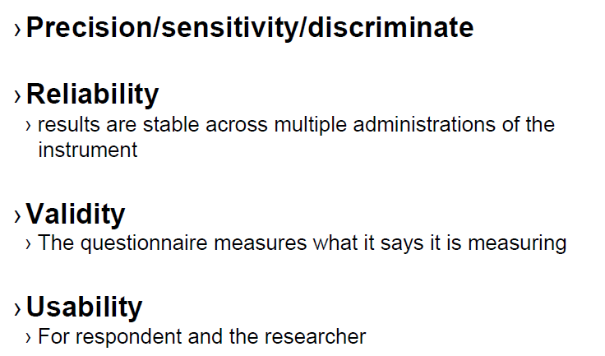
Design Requirements

Slide 16
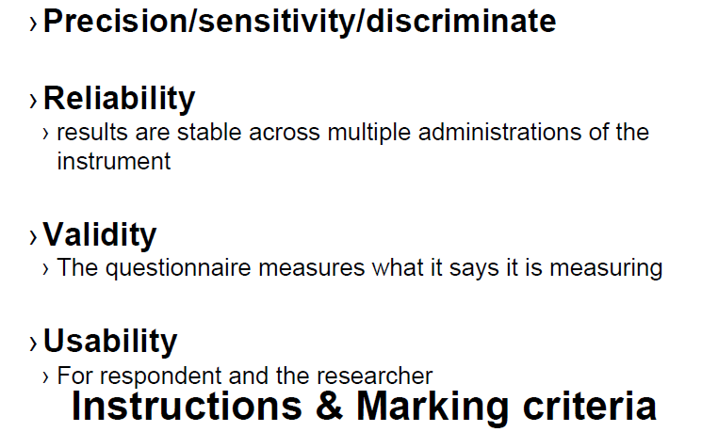

Slide 17
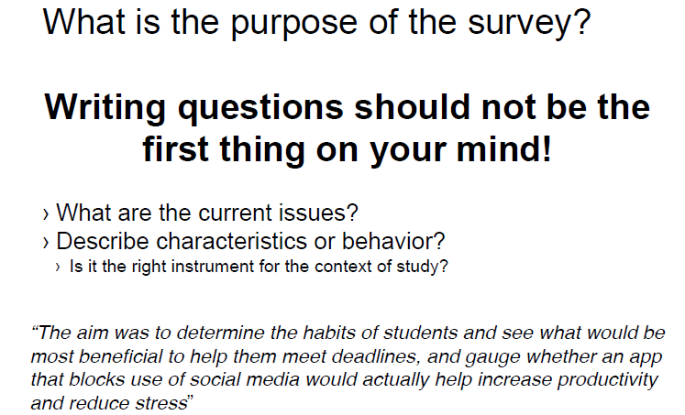

Slide 18
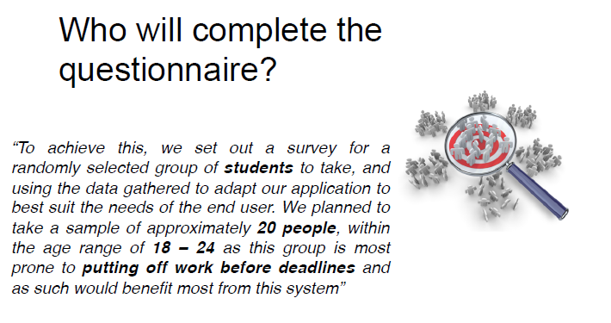

Slide 19
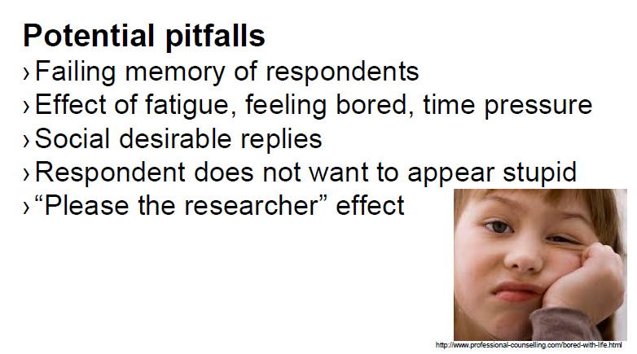

Slide 20
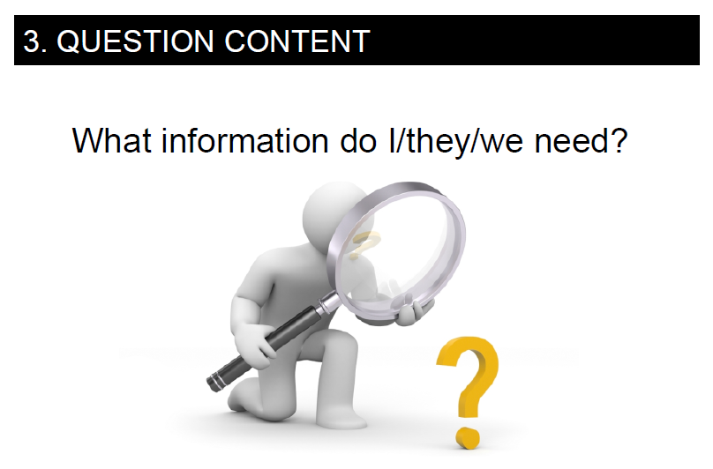

Slide 21
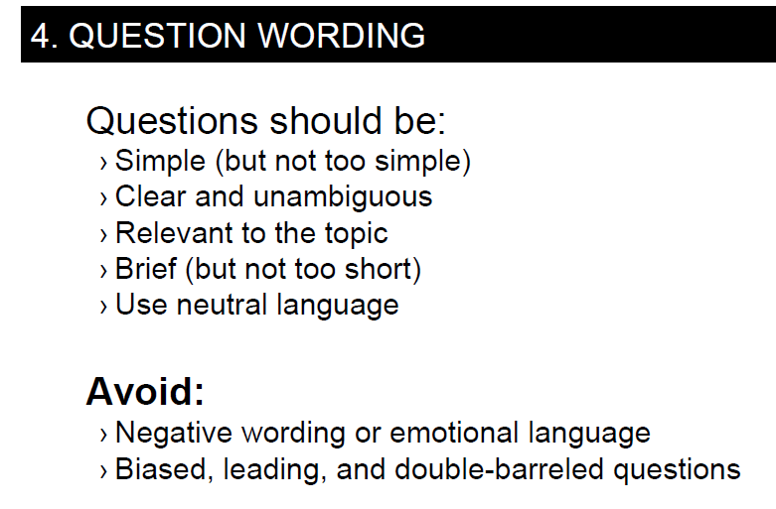

Slide 22
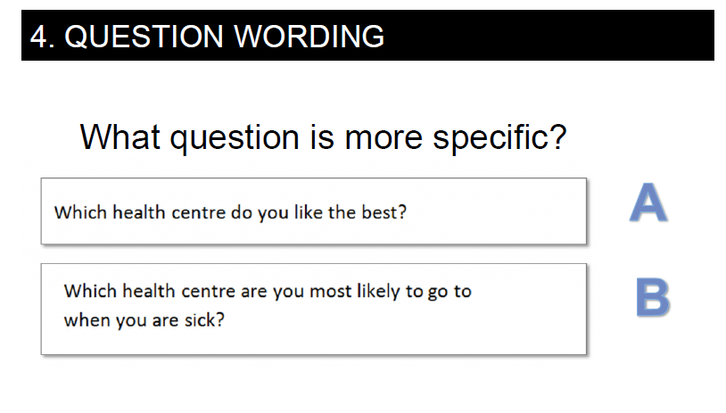

Slide 23
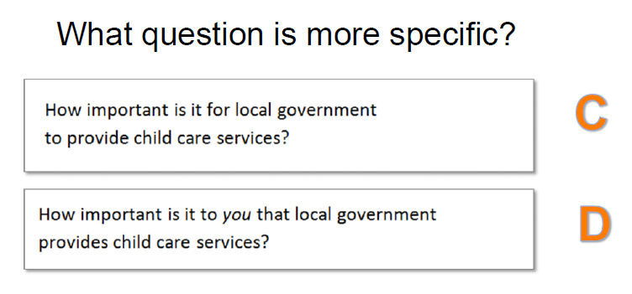

Slide 24
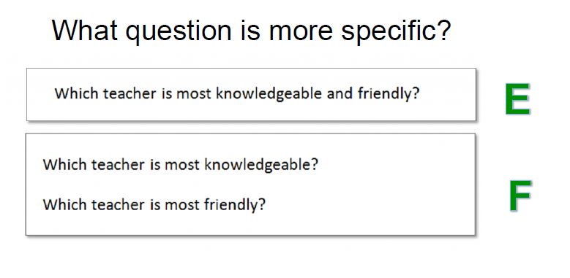

Slide 25
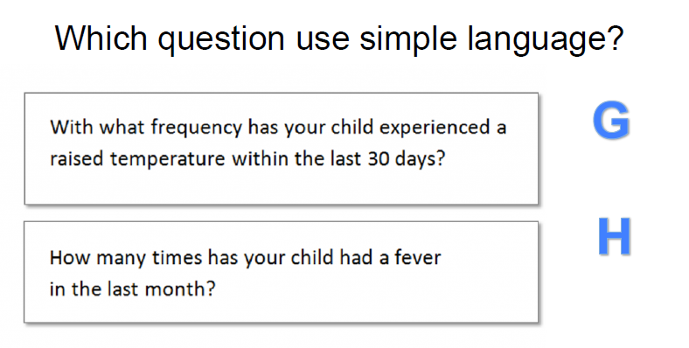

Slide 26
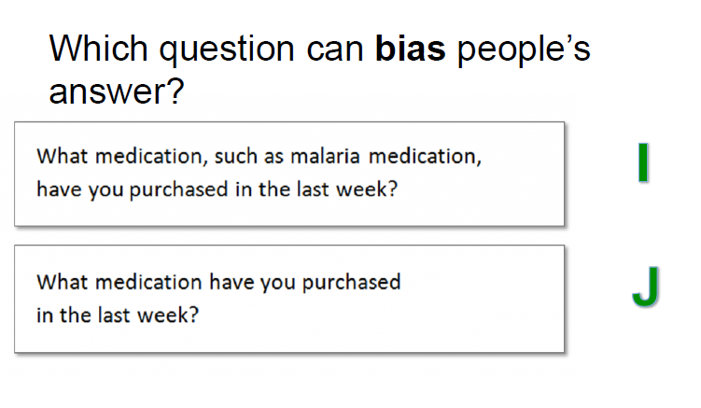

Slide 27
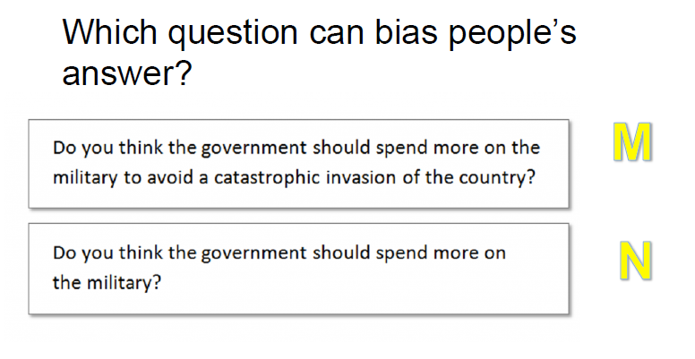

Slide 28
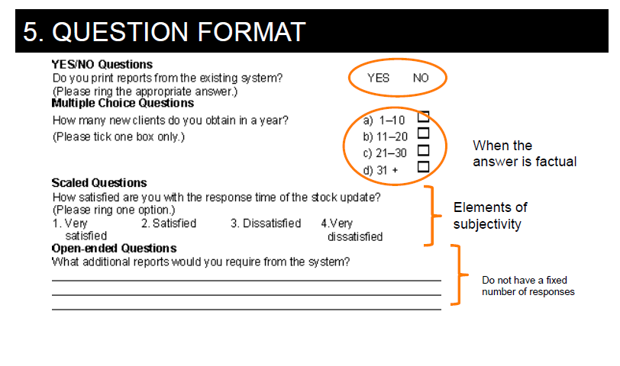

Slide 29
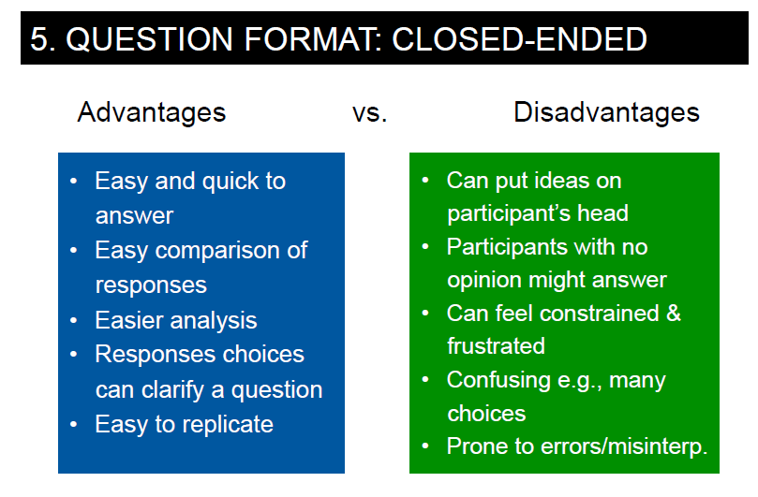

Slide 30
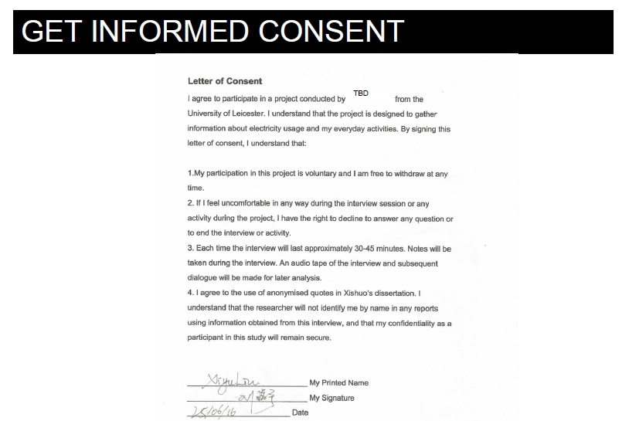

Slide 31
Interviewing Techniques

Slide 32
Customer and User Interviews
Customer Interviews
Goals in purchasing the product
may not be the same as the end users.
Frustrations with current solution
Domain related issues and Vocabulary

Slide 33
Interview Types
Unstructured Interviews
Structured Interviews
Options for answers are limited
Semi-Structured Interviews
Notes:
probing

Slide 34
Interview
If you were designing a lecture support system
Who would you interview?

Slide 35
Choosing Participants
Representative of target users
May be current users of a similar system
Might also be non-users

Slide 36
Teacher
Students
Freshman
PhD
Stronger and weaker students
People with different backgrounds
Teaching Staff
Department Admin?
Parent?

Slide 37
Recruiting Participants
Get a diverse set of stakeholders
Use incentives and motivation
Approximate - better than nothing
Medical students instead of doctors
Computer students instead of software engineers
Not Ideal but better then nothing
You can ask people you know to refer you to other people they know

Slide 38
Recruiting Participants
Look for people in the middle instead of at the top
They are the ones who do the actual work
Also they will be more willing to talk.
People at the top don’t have time and they are very self conscious about what they will say.

Slide 39
What Are Good Questions?

Slide 40
“Is the daily update an important feature to you?”
What do you thing they will say?
“Would you like stores with less clutter?”
Do you want CU online to be more user friendly?
You like feature X don’t you?
Do you agree that a task manager would help you in your everyday life?
How stressful do you find getting up early in the morning?
Most of these questions are leading questions

Slide 41
Other Types of Questions to avoid
What they would do / like / want in hypothetical scenarios
People are not designers, they may not know what to say
For example Henry Ford said in the day of horse and buggy if you had asked what they wanted
They would have said a faster horse
The designers see the possibility of the car
People are not experts designers but they are experts of their lives so ask them about that.

Slide 42
How often they do things
We often lie to ourselves
If asked how often do you exercise?
Instead make them concrete.
Instead ask how many times did they exercise last week. That is more concrete and more recent in their memory
How much they like things on an absolute scale
What does 7 mean?
Avoid binary Questions
Do you like grape fruit?
Yes
Not a very interesting question.

Slide 43
So what are good questions
Especially at the beginning of the interview ask open ended questions.

Slide 44
How to Conduct Interviews
Introduce yourself, explain your purpose
The interview is about them, not you!
Begin with open, unbiased questions
Ask the question and let them answer

Slide 45
(a little bit of)
Silence is Golden

Slide 46
Follow Up
Adjust your questions to their previous answers
Ask questions in language they use / understand
Pick up on and ask for examples
Be flexible

Slide 47
Scheduled Interviews Facilitate Depth

Slide 48
Where to conduct interview?
Should you record audio or video?

Slide 49
Drawback of Audio/Video Recording
Time-consuming to review / edit
Can change participants’ responses
Requires permission

Slide 50
Benefits
A robust record
Highlights are GREAT for communication
Helps you focus on interviewing

Slide 51
Save Records - It’ll help later
Keep photos, notes, and artifacts
Helps tie all design to use, rather than debating things on an abstract plane

Slide 52
Some Example Questions
goal-oriented questions to consider:
Goals—What makes a good day? A bad day?
Opportunity—What activities currently waste your time?
Priorities—What is most important to you?
Information—What helps you make decisions?

Slide 53
Some Example Questions
system-oriented question:
Function—What are the most common things you do with the product?
Frequency—What parts of the product do you use most?
Preference—What are your favorite aspects of the product? What drives you crazy?
Failure—How do you work around problems?
Expertise—What shortcuts do you employ?

Slide 54
Some Example Questions
work flow-oriented questions can be helpful:
Process—What did you do when you first came in today? What did you do after that?
Occurrence and recurrence—How often do you do this? What things do you do
weekly or monthly, but not every day?
Exception—What constitutes a typical day? What would be an unusual event?

Slide 55
Some Example Questions
Attitude-oriented questions
To better understand user motivations
Aspiration—What do you see yourself doing five years from now?
Avoidance—What would you prefer not to do? What do you procrastinate on?
Motivation—What do you enjoy most about your job (or lifestyle)? What do you always tackle first?

Slide 56
Focus Groups
Focus Groups
A group of participants have a discussion on a topic directed by a researcher.
Pros
Get group opinion about issues
Efficient way to test early ideas/designs
Good way to identify issues or areas of conflict
Multi-constituent discussion
Cons
Can be taken over by assertive individuals
Focus on people’s opinions not actual behaviors
Limited sample size

Slide 57
Participant Observation

Slide 58
Observation
Direct observation in controlled environments
Indirect observation: tracking users’ activities
Diaries
Interaction logging
Video and photographs collected remotely by drones or other equipment

Slide 59
Participant Observation
Why do participant observation uncover more detail then interviews?
Participant observation can uncover things that are difficult to articulate.

Slide 60
Direct Observation in the Field
A usability consultant joins a group of tourists who have been given a wearable navigation device that fits onto a wrist strap to test on a visit to Stockholm. After sightseeing for the day, they use the device to find a list of restaurants within 2 kilometers of their current position. Several are listed, and they find the phone numbers of a few, call them to ask about their menus, select one, make a booking, and head off to the restaurant.
The usability consultant observes some difficulty operating the device, especially on the move. Discussion with the group supports the evaluator’s impression that there are problems with the interface, but on balance the device is useful, and the group is pleased to get a table at a good restaurant nearby.

Slide 61
Direct Observation in the Field
All data gathering should have a clearly stated goal, but it is particularly important to have a focus for an observation session because there is always so much going on.
On the other hand, it is also important to be prepared to change the plan if circumstances change.

Slide 62
Structuring frameworks to guide observation
Three easy-to-remember parts:
The person: Who?
The place: Where?
The thing: What?
A more detailed framework (Robson, 2014):
Space: What is the physical space like and how is it laid out?
Actors: What are the names and relevant details of the people involved?
Activities: What are the actors doing and why?
Objects: What physical objects are present, such as furniture
Acts: What are specific individual actions?
Events: Is what you observe part of a special event?
Time: What is the sequence of events?
Goals: What are the actors trying to accomplish?
Feelings: What is the mood of the group and of individuals?

Slide 63
Planning and conducting observation in the field
Decide on how involved you will be: from passive observer to active participant
How to gain acceptance
How to handle sensitive topics, for example, culture, private spaces, and so on
How to collect the data:
What data to collect
What equipment to use
When to stop observing

Slide 64
Ethnography
Ethnography is a philosophy with a set of techniques that include participant observation and interviews
Debate about differences between participant observation and ethnography
Ethnographers immerse themselves in the culture that they study
A researcher’s degree of participation can vary
Analyzing video and data logs can be time-consuming
Collections of comments, incidents, and artifacts are made

Slide 65
More on Ethnography
Co-operation of people being observed is required
Informants are useful
Data analysis is continuous
Interpretivist technique
Questions get refined as understanding grows
Reports usually contain examples
65

Slide 66
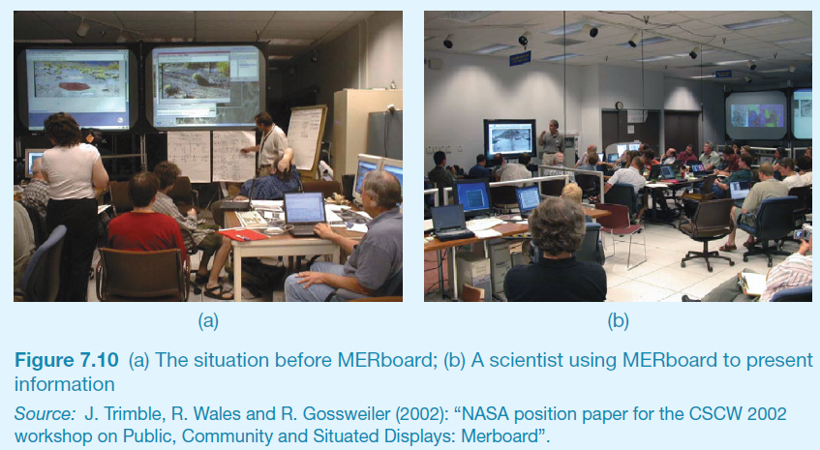
More on Ethnography (continued)
Figure 8.9 (a) The situation before MERboard; (b) a scientist using MERboard to present information
Source: J. Trimble, R. Wales and R. Gossweiler (2002): “NASA position paper for the CSCW 2002 workshop on Public, Community and Situated Displays MERBoard.
66
Notes:
The MERboard is a tool scientists and engineers use to display, capture, annotate, and share
information in support of the operation of two Mars Exploration Rovers (MERs) on the surface
of Mars. The MER (see Figure 8.8) acts like a human geological explorer by collecting
and analyzing samples and then transmitting the results to the scientists on Earth. The scientists
and engineers collaboratively analyze the data received, decide what to study next, create
plans of action, and send commands to the robots on the surface of Mars.
The requirements for MERboard were identified partly through ethnographic fieldwork,
observations, and analysis (Trimble et al., 2002). The team of scientists and engineers
ran a series of field tests that simulated the process of receiving data, analyzing it,
creating plans, and transmitting them to the MERs. The main problems they identified
stemmed from the scientists’ limitations in displaying, sharing, and storing information
(see Figure 8.9a).

Slide 67
Online Ethnography
Virtual, Online, Netnography
Online and offline activity
Interaction online differs from face-to-face
Virtual worlds have a persistence that physical worlds do not have
Ethical considerations and presentation of results are different
67

Slide 68
Direct observation in a controlled environment
Direct observation
Think aloud techniques
Indirect observation – tracking users’ activities
Diaries
Interaction logs
Web analytics
Video, audio, photos, and notes are used to capture data in both types of observations
68
Notes:
Diaries are useful: when participants are scattered and unreachable in person; when the
activity is private, for example, in the home; or when it relates to feelings, for instance, emotions
or motivation. For example, Jang et al. (2016) used diaries with interviews to collect
data about users’ experiences with smart TVs in the home as compared to within a controlled
lab setting. The study in the home was conducted over several weeks during which
participants were asked to keep a diary of their experiences and feelings. Surveys were also
collected. This mixed-methods study informed the user experience design of future systems.

Slide 69
Choosing and combining techniques
Depends on the:
Focus of the study
Participants involved
Nature of the technique(s)
Resources available
Time available
69

Slide 70
Which Technique would be Appropriate
A new software app to support a small organic produce shop. There is a system running already with which the users are reasonably happy, but it is looking dated and needs upgrading.
An innovative device for diabetes sufferers to help them record and monitor their blood sugar levels.
An ecommerce website that sells fashion clothing for young people.

Slide 71
Basic quantitative analysis
Averages:
Mean: Add up values and divide by number of data points
Median: Middle value of data when ranked
Mode: Figure that appears most often in the data
Percentages
Be careful not to mislead with numbers!
Graphical representations give overview of data
4

Slide 72
Basic qualitative analysis
Looking for critical incidents
Helps to focus in on key events
Then analysis can proceed using specific techniques
Identifying themes
Emergent from data, dependent on observation framework if used
Inductive analysis
Categorizing data
Categorization scheme pre-specified
Deductive analysis
In practice, combination of inductive and deductive

